Slide 1
Uber NYC Rideshare Trip Information
By
- Havish Manikya Vakkalanka
- Rohith kumar Koutike
- Sai Akhil Sadula

Slide 2
Introduction
The project involves analyzing Uber NYC for-hire vehicles trip data for the year 2021.
In New York City, all taxi vehicles are managed by TLC (Taxi and Limousine Commission) established in 1971.
It responsible for licensing and regulating New York City's Medallion (Yellow) taxi cabs, for-hire vehicles and FHV vehicles( High Volume for Hire Vehicles).
We have selected UBER because it is One of the biggest ride-hailing services providers, its trip records are collected in High Volume For-Hire Vehicle Trip Records as well.

Slide 3
Project Objective
Managing and processing enormous volumes of data generated from millions of rides and transactions dail.
Handling and analyzing data streams to make immediate decisions for activities such as surge pricing, route optimization, and demand forecasting, requiring fast data processing capabilities.
Dealing with diverse data types, including geospatial data, customer preferences, payment information, and driver details, and integrating these varied data sources for comprehensive analytics and insights.
Ensuring the security and privacy of sensitive data, such as user information and financial transactions, while complying with regulatory requirements and protecting against potential data breaches.

Slide 4
Data Sources and Collection
Uber NYC for-hire vehicles trip data (2021) on Kaggle
- Data size ~ 5 GB
Link to the source data:
https://www.kaggle.com/datasets/shuhengmo/uber-nyc-forhire-vehicles-trip-data-2021

Slide 5
About Dataset
•Data set contains 1,19,08,464 entries of data with 24 columns.
•Data set includes columns such as Vehicle Number, Pickup Time, Drop Time, Trip Miles, Trip Time which will be used for analysis.
•Link to the Data set:
https://www.kaggle.com/datasets/shuhengmo/uber-nyc-forhire-vehicles-trip-data-2021

Slide 6
Analysis on the dataset
Pricing Strategy Analysis - Analyze the trained model's coefficients or feature importances to understand how time of day, location, and weather conditions impact taxi fares.Identify pricing trends, anomalies, and any significant insights.Visualize the findings to communicate results effectively.
Optimization Recommendations - Based on the analysis, provide recommendations for optimizing the pricing strategy. This could include dynamic pricing adjustments based on factors like time of day or weather conditions.Consider how these recommendations align with business goals and customer preferences.
Temporal Analysis: Analyzing the number of trips over time (e.g., hourly, daily, weekly). Identifying peak hours, days, or months for trips.
Revenue Analysis: Analyzing the revenue generated over time. Investigating the factors affecting revenue (e.g., trip distance, time, day of the week).

Slide 7
Big Data Tools and Technologies
Data Ingestion and Preprocessing :
Input NYC taxi data into HDFS, a distributed file system that handles big amounts. We use it to store raw data from large tables.
Analysis with MapReduce: MapReduce job in Hadoop or any other language to calculate the determine the price strategies. Convert the dataset into a format suitable for analysis, handling missing values and outliers.
Apache Spark: Spark is a powerful framework for distributed data processing. We are planning to use it to perform data transformations, aggregations, and analyses on our data.
Data Visualization (using Tableau).

Slide 8
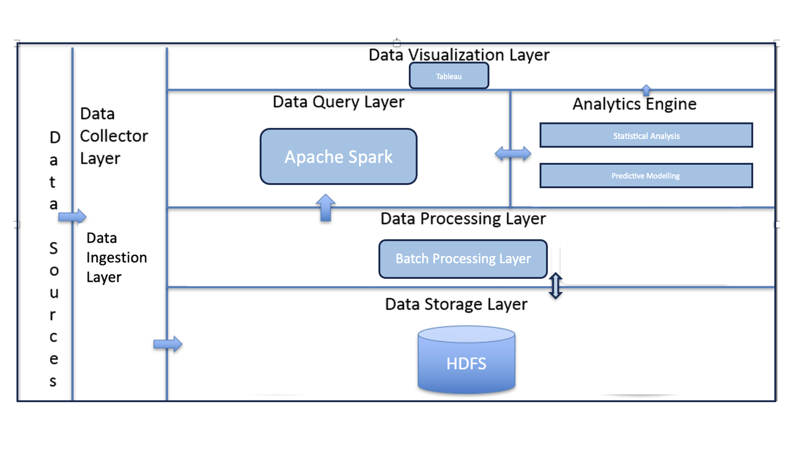
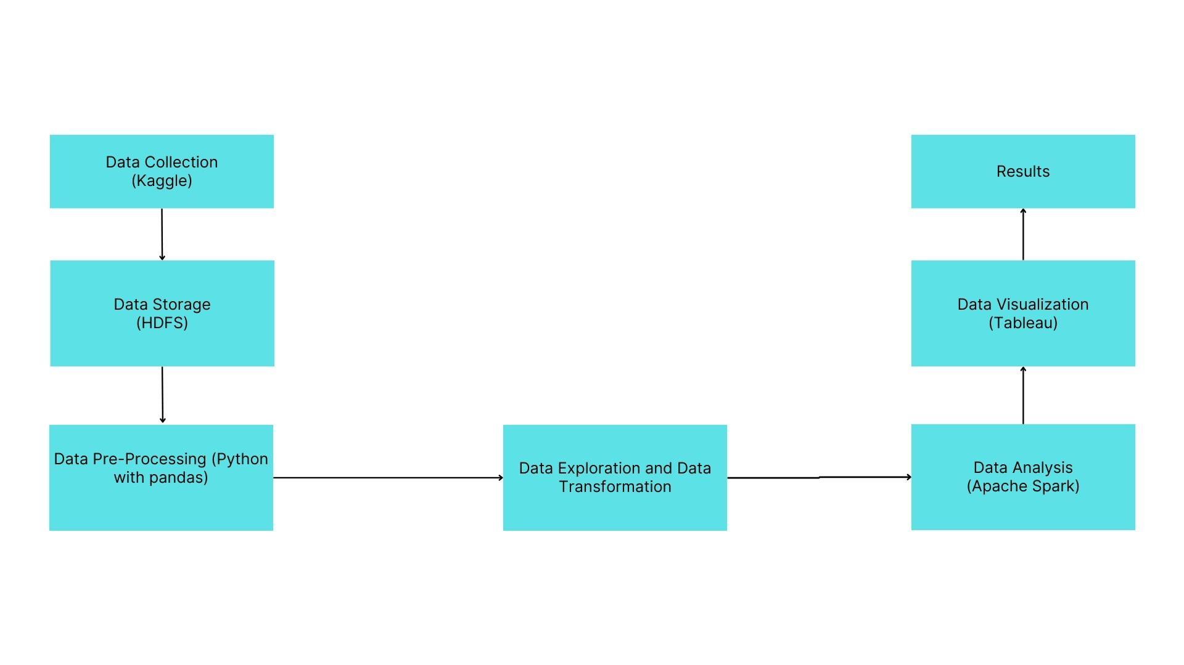
Architecture(Stack Diagram)

Slide 9
Expected Results
To analyze and identify pricing trends and anomalies in taxi fare prices based on time of day, location, and weather conditions to optimize the pricing strategy for a taxi company.
To find insights into when most taxis are requested, you can analyze the data by time of day.
Calculating the average distance traveled by taxis can provide valuable insights into the typical taxi ride.
To determine the taxi zone where more taxis are requested, you can analyze the data to identify the geographic areas with the highest demand for taxi services.

Slide 10
Timeline
Tasks | Duration
Defining the objectives and requirements (identify data sources) | 1 week
Data Ingestion (load the data into HDFS) | 1 week
Spark Data processing (Read the data from HDFS into spark and Apply data transformations) | 2 weeks
Data Analysis (EDA) | 2 weeks
Data Visualization (Insights and patterns) | 1 week
Documentation | 1 week

